Slide 1
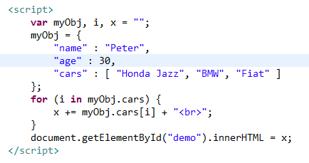
JSON Arrays
We can access array values by using a for-in loop

